Slide 1
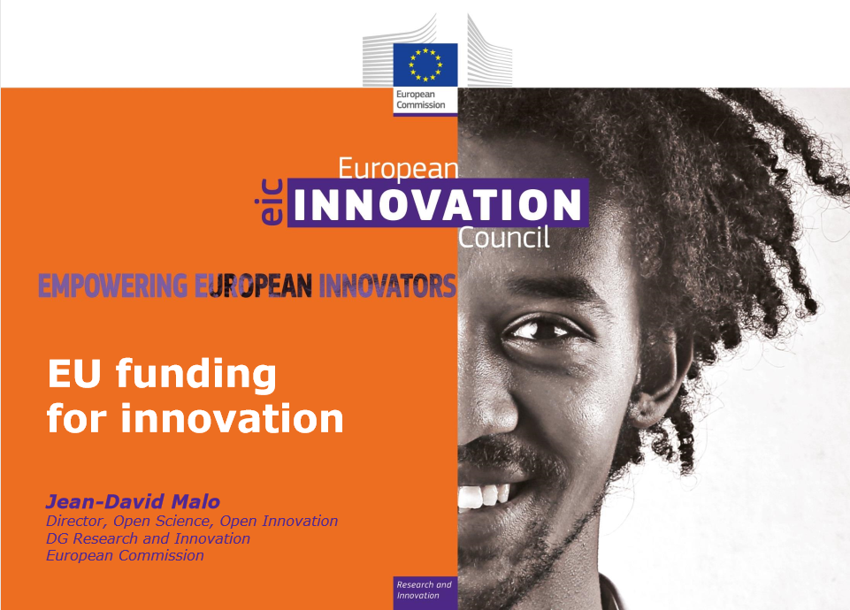

Slide 2
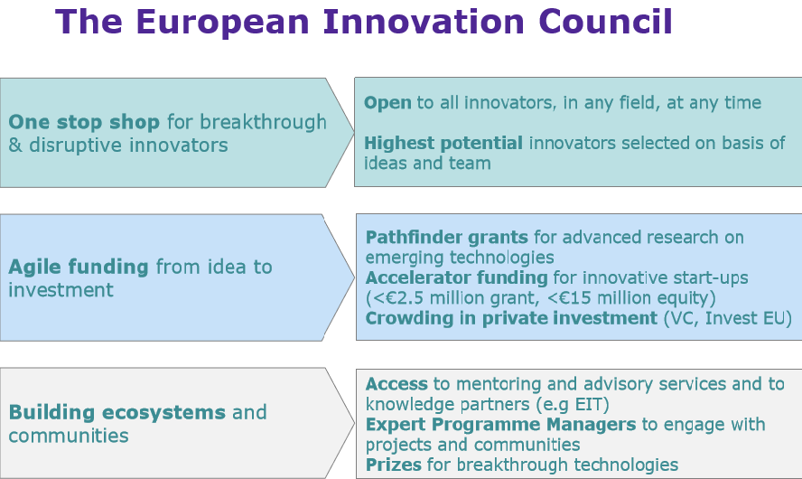
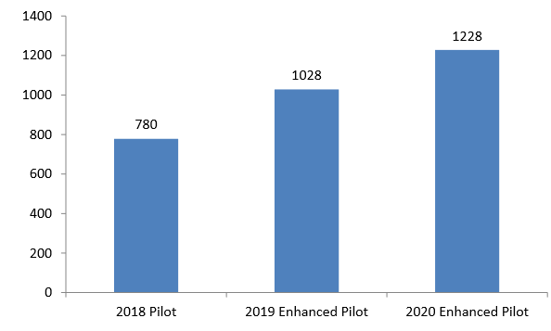
Total estimated budget, M€
Full EIC under Horizon Europe (2021-27)
✓ Proposed budget of €10 billion
✓ More flexible rules for funding (ability to stop or reorient, links to Invest EU) with increased role for expert programme managers
✓ Full Pathfinder scheme for grants in advanced research and Transition Activities
✓ Fast track access for Horizon grant holders (incl. European Research Council)
Notes:
<number>

Slide 3
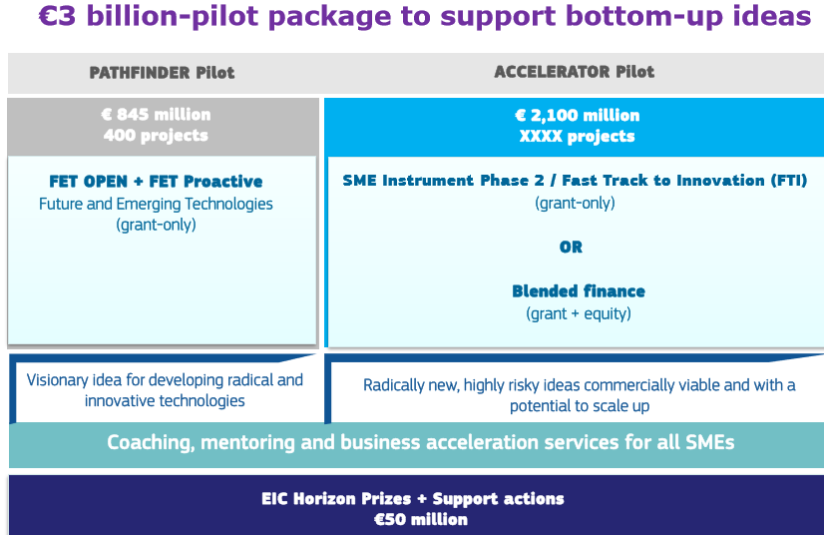
I phase launched
in 2018
II phase launched in 2019
✓ Increased budget of €2.2 billion (€1.0bn in 2019; €1.2bn in 2020)
✓ Introduction of Pilot Accelerator with option to apply for blended finance (combined grant and equity)
✓ Introduction of Pilot Pathfinder, with 6 strategic emerging technologies targeted (human-centric AI, novel medical devices, zero-emission energy generation, etc)
✓ First EIC 3 to 5 programme managers recruited to actively engage with pathfinder projects (¡to better check scores! Al least 1 PM per each of the 3 areas in 2019/ 3 more areas to be launched in 2020/ to start around Sept. 2019, before grant signature or project start)
✓ Bringing together relevant Horizon 2020 schemes in one place (SME instrument, Fast Track to Innovation, FET Open, Prizes)
Total budget in 2018: €780 million for all EIC pilot actions
Notes:
<number>

Slide 4
FTI / Fast Track to Innovation
• Fast go-to-market of an industry-driven, innovative concept to grow and scale-up.
• Co-creation and open innovation.
• Grant-only
• Bottom-up
• Consortia of 3-5 — mandatory industry involvement
• Up to €3 million
• 36 months
Next cut-offs
23 May 2019
22 October 2019
19 February 2020
09 June 2020
27 October 2020

Slide 5
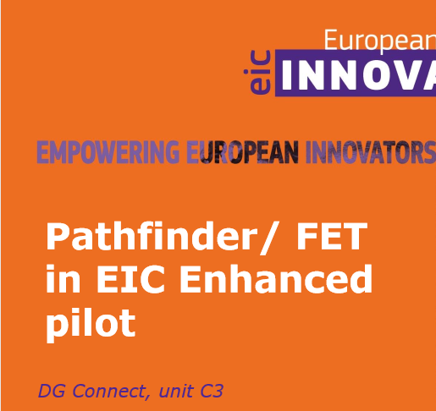
FET 3 topics in 2019:
Human-centric AI (Walter van de Velde)
Implantable Autonomous Devices and Materials (José Luis Fernandez Villacanas)
Breakthrough zero-emissions energy generation for full decarbonisation (Julian Ellis).
FET topics in 2020 (tbc):
Future technologies for social experience;
Measuring the unmeasurable -Sub-nanoscale science for Nanometrology;
Digital twins for the life-sciences;
Environmental Intelligence

Slide 6
The Pathfinder Pilot for advanced research builds on FET Open and Proactive!
Nurturing potential market-creating technologies, developing breakthrough and disruptive innovation
Run by Programme Managers hired from innovation ecosystem
Based on topics or challenges identified in the work programme and open bottom-up call for proposals
Support for assessing business opportunities (ILP) and preparing for Accelerator funding through “Transition to innovation activities".
Why FET in EIC? Main takeaways from 224 FET Open and Proactive projects (FET Traces report: https://www.fet-traces.eu/traces/index.php):
33% of projects had at least one publication written with the participation of an industrial partner
40% of projects had at least one partner from industry
25% of all projects had at least one patent
12% of FET projects led to the founding of a spin-off company
Pathfinder FET Open success rate is improving:
>11% in the last cut-off
will improve even more as the budget is strongly increasing.

Slide 7
EIC Pathfinder: science driven
Targets high-risk cutting edge projects exploring new territories aiming at developing radical and innovative technologies. It encompasses FETOpen and FET-Proactive.
FET-Open uses interdisciplinary collaboration to tap into Europe's excellent science base for exploring radically new technologies. Not obligatory to have an SME in the consortium or exploit the pilot.
FET-Proactive aims to: identify the future and emerging technological paradigms with highest potential for Europe's economy and society; foster the interdisciplinary communities that are able to drive this forward, extending from the participating consortia to a wider European pool of expertise; stimulate the emergence of a European innovation eco-system around a new technological paradigm, well beyond the world of research alone.
Cutting-edge high-risk / high-reward research and innovation projects that aim to demonstrate a new technological paradigm.

Slide 8
FET Proactive Evaluation Criteria
Excellence
• Clarity of long-term vision of a science-enabled technology.
• Concreteness and ambition of the proposed science-to technology breakthrough.
• Range and added value from interdisciplinarity, novelty and non-incrementality of the research proposed.
• High-risk of the research proposed and plausibility and flexibility of the approach.
Threshold: 4/5, Weight: 60%
Impact
• The extent to which the outputs of the project would contribute to the expected impacts mentioned in the work programme under the relevant FET topic.
• Effectiveness of measures and plans to disseminate and use the results (including management of IPR) and to communicate the project to different target audiences.
Threshold: 3.5/5, Weight: 20%

Slide 9
Proactive : Expected Impacts
• Scientific and technological contributions to the foundation and consolidation of a radically new future technology.
• Potential for future returns in terms of societal or economic innovation or market creation.
• Spreading excellence and building leading innovation capacity across Europe by involvement of key actors that can make a difference in the future, for example excellent young, researchers, ambitious high-tech SMEs or first-time participants to FET under Horizon 2020.
• Build-up of a goal oriented interdisciplinary community (within and beyond the consortium).
• Emergence of an innovation ecosystem around a future technology in the theme addressed from outreach to and partnership with high potential actors in research and innovation, and from wider stakeholder/public engagement, with due consideration of aspects such as education, gender differences and long-term societal, ethical and legal implications.

Slide 10
Quality and efficiency of the implementation
• Coherence and effectiveness of the work plan to achieve project objectives and impacts, including adequate allocation of resources to tasks and partners.
• Appropriateness of the research and innovation management structures and procedures.
• Role and complementarity of the participants and extent to which the consortium as a whole brings together the necessary expertise (They prefer original and interdisciplinary combinations within the consortium and not just “friends” working well together!!!)
Threshold: 3/5, Weight: 20%

Slide 11
FET Proactive: some peculiarities
• Interdisciplinarity is a must
• Consider Responsible Research and Innovation approach
• Proposals of max. 30 pages (section 1 to 3)
• Indicative budget and duration: 4-5M€, up to 4 years
• Cascaded grants (‘Annex K’) are allowed:
• for small scale experimentation by third parties outside of the consortium
• for prize organised by the project
• For AI topic and transition to innovation activities: exploitation in Europe preferred (special clause) (¡¡¡Fear to lose innovation in favor of US companies in particular!)

Slide 12
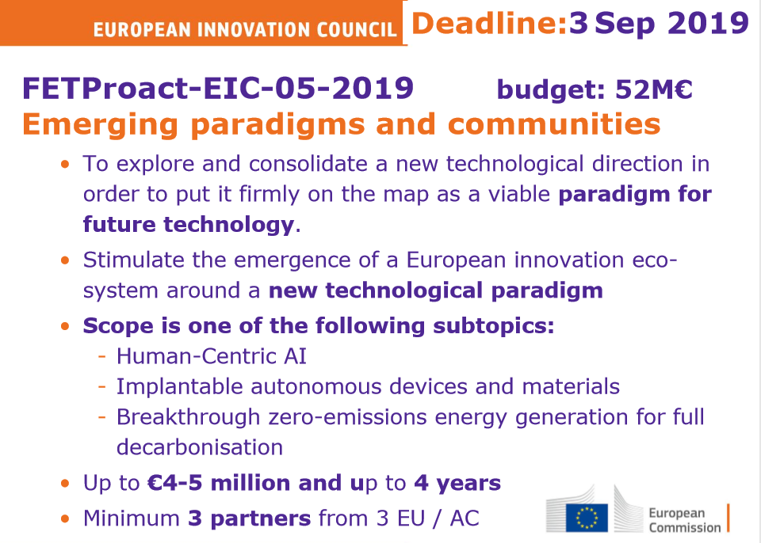

Slide 13
Sub-topic (a) Human-Centric AI (Walter van de Velde)
The projects are expected to contribute to the wider debate on the sociotechnical, organisational and AI-ethical dimensions of such technologies and systems, and link to the ’Commission’s broader AI strategy. **See Artificial Intelligence for Europe (COM(2018) 237 final, 25.4.2018) and Coordinated Plan on Artificial Intelligence (COM(2018) 795 final, 7.12.2018).
Objectives:
• Maximising benefits from AI (Economic impact + Contribution to societal challenges: healthcare, energy efficiency, road safety, cybersecurity etc.)
• Transparency and Accountability
• Robustness and Safety
• Data Governance and Privacy
• Diversity and Non-discrimination
• Human Autonomy and Oversight
• Societal and Environmental well-being
The problem
Explicability has become an essential element if users are to trust, accept and adopt the next generation of intelligent machines on a wider scale.
This initiative seeks to advance to the next AI frontier with verifiable, evidence-based features of trustworthiness (i.e., reliable and unbiased alignment of values, goals and beliefs) and transparency (explainable performance), exploring radically new approaches (e.g., inspired from neuro-science, cognition or social science).

Slide 14
Human-centric?
explanation tightly intertwined with the decision making process itself
decisions can be challenged, interpreted, refined and adjusted through mutual exchange, introspection (e.g., self-awareness of biases, reflecting on the internal functioning of the learning system, or on what caused a wrong or unacceptable decision)
active learning of both system and user, for example through dialogue or other forms of multi-modal interaction aimed at establishing mutual trust.
Solutions: Beyond the state-of-the-art
New data collection and ownership/governance models that go beyond the dominant off-line and centralised data processing should be investigated, and new avenues, such as for incremental, unsupervised, active, one-shot and ‘small data’ machine learning, should be explored.
Novelty often comes from radical interdisciplinarity – compose your consortium accordingly!
Clear potential for social sciences and humanities.

Slide 15
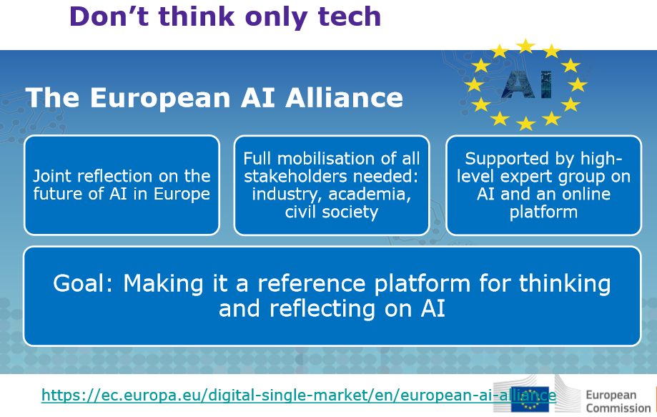

Slide 16
Sub-topic (b) Implantable autonomous devices and materials (José-Luis Fernandez-Villacanas)
Current implants do not last long/the materials are not bio-compatible/are not adaptable/no clever sensing/no shape/function change/no movement/no power management
Challenge and Scope: Radically new biomedical tech is needed for implantable devices and materials with dramatically longer functional lifetimes.
Ex. of properties: Smart sensing, self-awareness, Adaptation (form and function), Bio-mimetism, Self-repair, In-situ integration.
Practical examples (e.g. micro/nano devices): Autonomously moving/ Distinguish tissue types, Sensing and Acting Delivering therapeutic agents.
!!Power generation/ management, Ethical implications of the technologies
Impacts: New exciting science and technology, Creating the community of researchers and innovators that will change the future, Potential returns for society, economy and markets

Slide 17
Sub-topic (c) Breakthrough zero-emissions energy generation for full decarbonisation (Julian Ellis)
Present transport engines (eg petrol/diesel/jet) release much waste energy. Waste energy is used to heat the vehicles (cold climates), power air-conditioning (hot regions) or for auxiliary systems (eg equipment environment).
Electric vehicles much more efficient – little waste heat.
Inefficient to use batteries for heating:
• Battery capacity needed to maximise range
• Electricity production from thermal energy ~ 30% efficient
Compact, portable, zero-emission energy source needed. Is there anything better than batteries/fuel cells?
Proposals should:
• Address new technologies (high risk) for energy generation with potential for significant take-up
• Bring together a European interdisciplinary pool of expertise to reach its goal, and encourage outside interest to increase the community working on the area
• Lay the foundations for a European innovation ecosystem (not only researchers) that can pursue the development after the project

Slide 18
Scope
Any safe form of thermal or electrical energy generation
Proposed technology should produce no CO2
Equipment should be compact and portable:
• Transportable by lorry, boat, aircraft, people, ….
• Not built in to a fixed location
• Higher energy density than batteries
Identified application area
Minimal or no rare/toxic materials
Competitive (low cost)
Clear/ambitious performance targets and milestones needed
Work on batteries, solar cells, fuel cells excluded
EX:
Hydrogen storage eg metal hydrides • Large, safe, increase in storage density possible?
Plasma systems • Plasmas are the most energetic state of matter • Can they be confined in a portable device?
Cavitation systems • Cavitation assisted energy harvesting systems: • Can they provide enough energy in a portable form?

Slide 19
Expected impact
Foundations for new portable energy technologies
Building up interdisciplinary communities with: young researchers, high-tech SMEs, first time FET participants
… leading to Emergence of new innovation ecosystems able to develop the market potential of the new tech, including wider stakeholder engagement beyond researchers alone.
Budget allocation: Total budget for all 3 sub-topics is 52 M€
Proposals from all 3 sub topics ranked in one list according to score.
Proposals selected for funding according to ranking list as follows:
Top two proposals from each sub-topic funded
3rd proposal from each sub-topic funded if budget available
Proposals funded from global list until budget exhausted

Slide 20
FETPROACT-EIC-06-2019: EIC Transition to Innovation Activities
• Gap between end of typical FET project and next opportunity: FTI, SMEi
• Improving chance of turning FET research into innovation
• Increasing technological readiness of research outcomes
The Challenge
• Create a fertile ground for FET research results to mature to a level where they start to be interesting for investors.
• Turn FET projects promising results into genuine technological breakthrough and disruptive innovations.
Scope
• Advancing TRL of promising technologies starting at TRL 2/3
• Business driven visionary leadership
• Essential capabilities to increase the maturity of targeted technology
• E.g. activities with TT partners, licence-takers, investors and users
Areas: Micro- and Nanotechnologies; AI and advanced robotics; Life sciences, health & treatment; Energy technologies; Interaction technologies (incl. VR,AR, Mixed Reality)
Expected Impact: Increased value from FET projects, Fast development & take-up of promising FET technologies, Increased H2020 first time participation of high tech SMEs, Leveraging more private investment into research and innovation

Slide 21
Conditions Transition to Innovation
• Total budget: 16M€
• Small RIA up to 24 months
• EU contribution: 1-2M€
• Explicit links with H2020 FET OPEN and PROACT project(s)
• No duplications with activities of the original project(s)!
• Well-defined intended outcome, KPIs
• Strong exploitation plan with market potential
• Agreement on project(s) IPRs in proposal

Slide 22
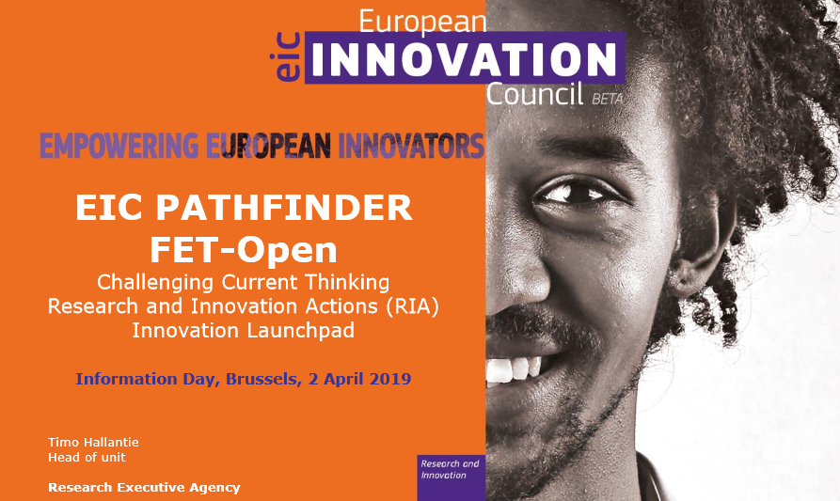
FET-Open: Novel ideas for radically new technologies (Timo Hallantie, Head of Unit, REA)
Aims to establish European leadership in the early exploration of future technologies.
It looks for opportunities of long-term benefit for citizens, the economy and society.
It aims to mobilise Europe's most creative and forward thinking researchers from all disciplines to work together and explore what may become the leading technology paradigms of the future.
• FETOPEN-01-2018-2019-2020: FET-Open Challenging Current Thinking
DEADLINES: 18 Sept. 2019, 13 May 2020
• FETOPEN-03-2018-2019-2020: FET Innovation Launchpad
DEADLINES: 8 Oct. 2019, 14 Oct. 2020

Slide 23
FET-Open Research & Innovation Actions - RIA:
Strengthen breakthrough innovations and boost the number of high-growth companies
Focus on people, companies and research organisations with ideas for :
• Radically new, breakthrough products, technologies, services, processes or business models that open up new markets with the potential for rapid European and global-scale growth (high risk, need for significant investment)
• Take shape at the intersection between different technologies, industry sectors and scientific disciplines.
• No thematic restriction (highly interdisciplinary)
• Completely bottom-up, but with a clear technological target
• Collaborative research (min. 3 partners from different MS/AC)
• Successful FET-Open project can be a proof-of-concept…
• EU contribution of up to 3M€ (indicative)

Slide 24
FET-Open Research & Innovation Actions - RIA:
Scope
Cutting-edge high-risk / high-impact interdisciplinary research with ALL of the following essential characteristics so-called "FET gatekeepers":
• Radical vision: the project must address a clear and radical vision, enabled by a new technology concept that challenges current paradigms. In particular, research to advance on the roadmap of a well-established technological paradigm, even if high-risk, will not be funded.
• Breakthrough technological target: the project must target a novel and ambitious science-to-technology breakthrough as a first proof of concept for its vision. In particular, blue-sky exploratory research without a clear technological objective will not be funded.
• Ambitious interdisciplinary research for achieving the technological breakthrough and that opens up new areas of investigation. In particular, projects with only low-risk incremental research, even if interdisciplinary, will not be funded.
https://www.youtube.com/watch?v=t8dAJvoiguM

Slide 25
FET-Open Research & Innovation Actions - RIA:
Challenges
• Lay the foundations for radically new future technologies;
• Visionary interdisciplinary collaborations that dissolve the traditional boundaries between sciences and disciplines;
• Encourage the driving role of new actors in research and innovation including excellent young researchers, ambitious high-tech SMEs and first-time participants to FET under Horizon 2020 from across Europe.
Expected Impact
• Scientific and technological contributions to the foundation of a new future technology
• Potential for future social or economic impact or market creation
• Building leading research and innovation capacity across Europe by involvement of key actors that can make a difference in the future, for ex. young researchers, high-tech SMEs or first-time participants to FET under Horizon 2020.

Slide 26
FET-Open Research & Innovation Actions - RIA:
Evaluation process
Sections 1 to 3 of the part B of the proposal should consist of a max. of 15 A4 pages
Sections 4 to 5 are not covered by the page limit.
Eligibility:
1. Its content corresponds, wholly or in part, to the topic description for which it is submitted (so called in-scope, contrary to out-of-scope). Proposals not satisfying all FET gatekeepers will be considered out-of-scope.
2. At least 3 legal entities in the consortium. Each must be established in a different EU MS or Horizon 2020 AC; must be independent of each other.

Slide 27
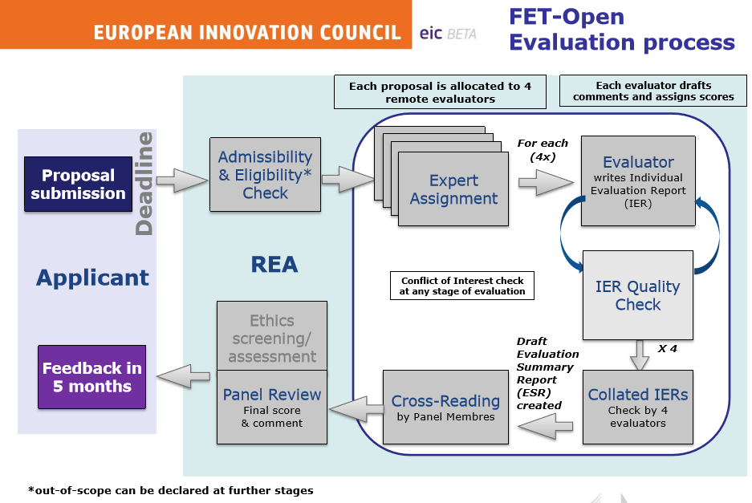

Slide 28
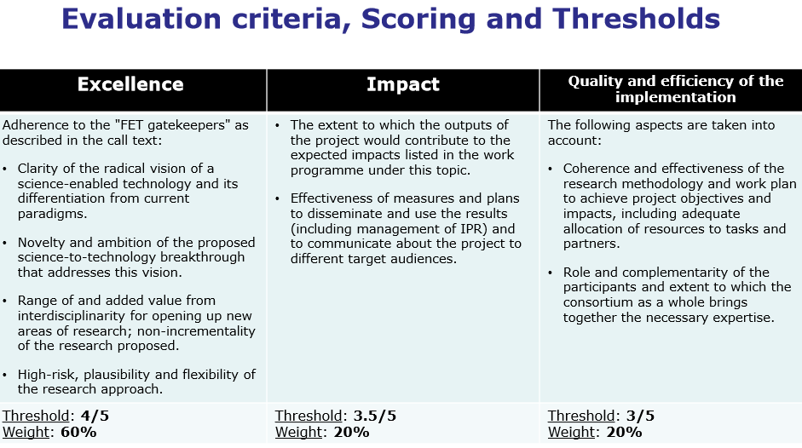

Slide 29
Feedback to applicants: Evaluation Summary Report (ESR)
• Collation of all individual comments, per sub-criterion, from all 4 Individual Evaluation Reports (IER) – may be mutually contradicting (no consensus): full transparency
• Consensus score of the proposal, per criterion, is calculated as a median of all individual scores from IERs
• Final score, per criterion, is decided by the final Panel Review and the proposal total score is calculated as a weighted sum of scores from all 3 criteria (60%/20%/20%)
• Final Panel Review adds also some additional comments, possibly including the advice not to resubmit the proposal

Slide 30
FET-Open Innovation Launchpad
• Turning FET-funded results into genuine societal or economic innovations - results from recently finished or on-going FET RIA-project
• Up to 18 months
• Sole applicant or as part of a consortium
• Maximum funding €100,000
• No funding to activities that were in the original FET project
•Examples of activities
Definition of a commercialisation process
Market and competitiveness analysis
Technology assessment
Verification of innovation potential
Consolidation of intellectual property rights
Business case development
• Limited low-risk technology development - if clear and necessary role the broader proposed innovation strategy & plan.

Slide 31
TIPS:
Key words and trend topics H2020 come from projects such as PREFET (organising an event in Sept. In Madrid. Contact Eva García Muntión, evagarcia@rtdi.eu):
RTDI coordinará PREFET, observatorio proactivo para la identificación temprana de tendencias tecnológicas, tras haber ganado una FET CSA de H2020
early identification of technological trends, which will be strongly linked to social responsibility and the future potential for the construction of R + D + i projects
objective of pre-validating future and emerging technologies.
FET Open: SMEs participation not a must
General: use máximum number of key words, well justified consortium, continuous dissemination (don’ t focus all dissemination activities at the end of the project), focus on scope, reflect correctly and justify as much as possible the call’ s objectives and suitability.

